Slide 1
A Contribution to Reinforcement Learning; Application to Computer Go
Sylvain Gelly
Advisor: Michele Sebag; Co-advisor: Nicolas Bredeche
September 25th, 2007

Slide 2
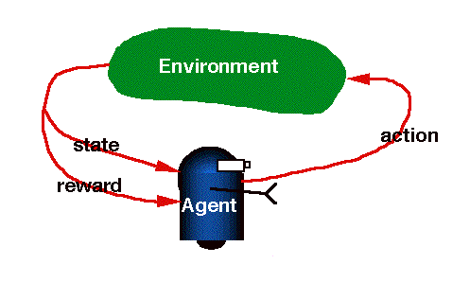
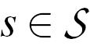
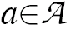
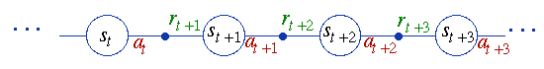
Reinforcement Learning: General Scheme
An Environment
(or Markov Decision Process):
State
Action
Transition function p(s,a)
Reward function r(s,a,s’)
An Agent: Selects action a in each state s
Goal: Maximize the cumulative rewards
Bertsekas & Tsitsiklis (96)
Sutton & Barto (98)

Slide 3
Some Applications
Computer games (Schaeffer et al. 01)
Robotics (Kohl and Stone 04)
Marketing (Abe et al 04)
Power plant control (Stephan et al. 00)
Bio-reactors (Kaisare 05)
Vehicle Routing (Proper and Tadepalli 06)
Whenever you must optimize a
sequence of decisions
Notes:
Add old reference

Slide 4
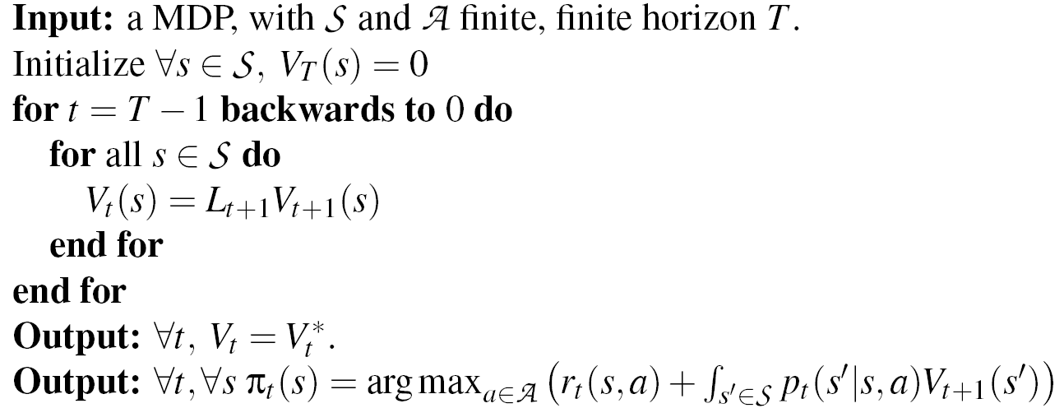
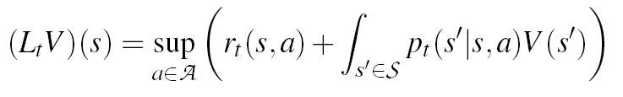
Basics of RL Dynamic Programming
Bellman (57)
Model
Compute the Value Function
Optimize over the actions gives the policy

Slide 5
Basics of RL Dynamic Programming

Slide 6
Basics of RL Dynamic Programming
Need to learn the model if not given

Slide 7
Basics of RL Dynamic Programming

Slide 8
Basics of RL Dynamic Programming
How to deal with that when too large or continuous?

Slide 9
Contents
Theoretical and algorithmic contributions to Bayesian Network learning
Extensive assessment of learning, sampling, optimization algorithms in Dynamic Programming
Computer Go
Notes:
Dire contrib theorique sampling

Slide 10
Bayesian Networks
Notes:
Lien avec RL

Slide 11
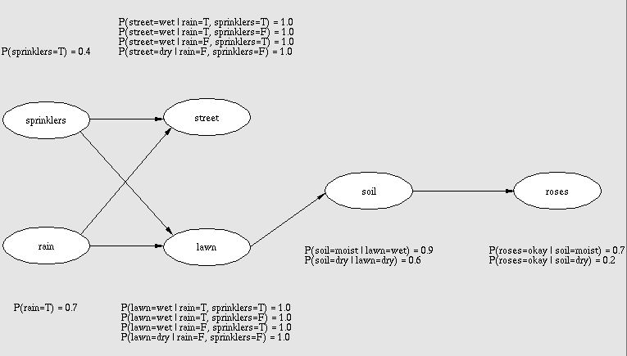
Bayesian Networks Marriage between graph and probabilities theories
Pearl (91)
Naim, Wuillemin, Leray, Pourret, and A. Becker (04)
Notes:
Parametric et non parametrique

Slide 12
Bayesian Networks Marriage between graph and probabilities theories
Parametric Learning
Pearl (91)
Naim, Wuillemin, Leray, Pourret, and A. Becker (04)
Notes:
Parametric et non parametrique

Slide 13
Bayesian Networks Marriage between graph and probabilities theories
Non Parametric Learning
Pearl (91)
Naim, Wuillemin, Leray, Pourret, and A. Becker (04)
Notes:
Parametric et non parametrique

Slide 14
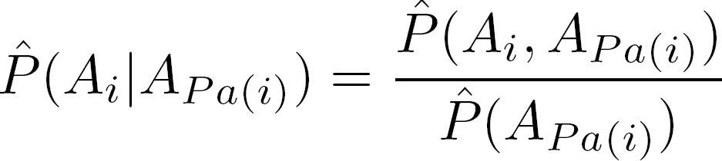
BN Learning
Parametric learning, given a structure
Usually done by Maximum Likelihood = frequentist
Fast and simple
Non consistent when structure is not correct
Structural learning (NP complete problem (Chickering 96))
Two main methods:
Conditional independencies (Cheng et al. 97)
Explore the space of (equivalent) structure+score (Chickering 02)
Notes:
References ici pour chaque partie
Rajouter les limitations de frequentist quand structure non correcte

Slide 15
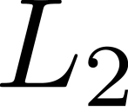
BN: Contributions
New criterion for parametric learning:
learning in BN
New criterion for structural learning:
Covering numbers bounds and structural entropy
New structural score
Consistency and optimality

Slide 16
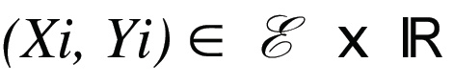
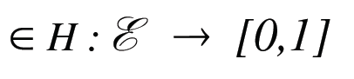
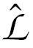
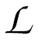
Notations
Sample: n examples
Search space H
P true distribution
Q candidate distribution: Q
Empirical loss
Expectation of the loss
(generalization error)
Vapnik (95)
Vidyasagar (97)
Antony & Bartlett (99)
Notes:
Empirical loss
Expectation of the loss
Search space => Model space

Slide 17
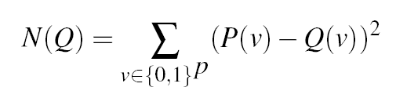

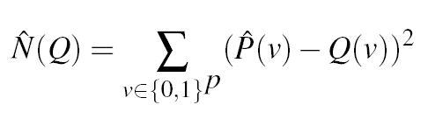
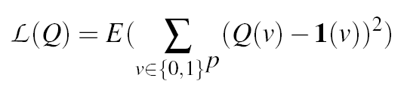

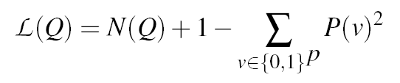
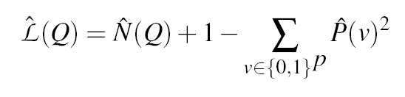
Parametric Learning (as a regression problem)
Define
( error)
Loss function:
Property:

Slide 18
Results
Theorems:
consistency of optimizing
non consistency of frequentist with erroneous structure

Slide 19
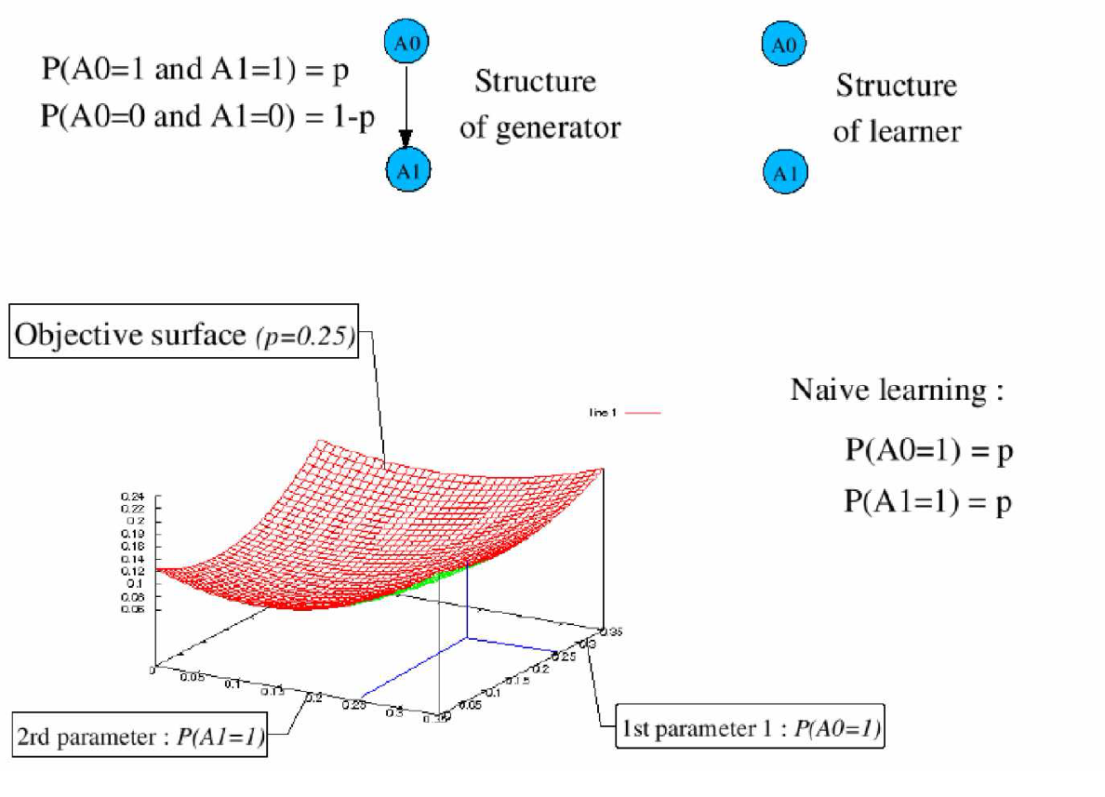
Frequentist non consistent when the structure is wrong

Slide 20
BN: Contributions
New criterion for parametric learning:
learning in BN
New criterion for structural learning:
Covering numbers bounds and structural entropy
New structural score
Consistency and optimality

Slide 21
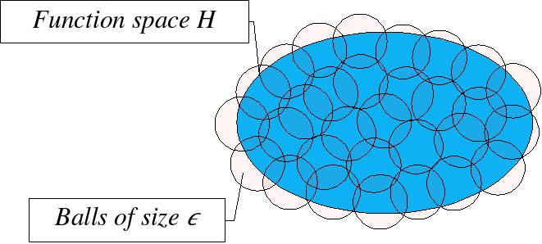
Some measures of complexity
VC Dimension: Simple but loose bounds
Covering numbers: N(H, ) = Number of balls of radius necessary to cover H
Vapnik (95)
Vidyasagar (97)
Antony & Bartlett (99)
Notes:
++ refs

Slide 22
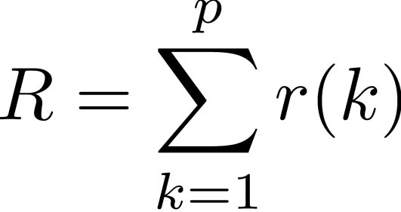
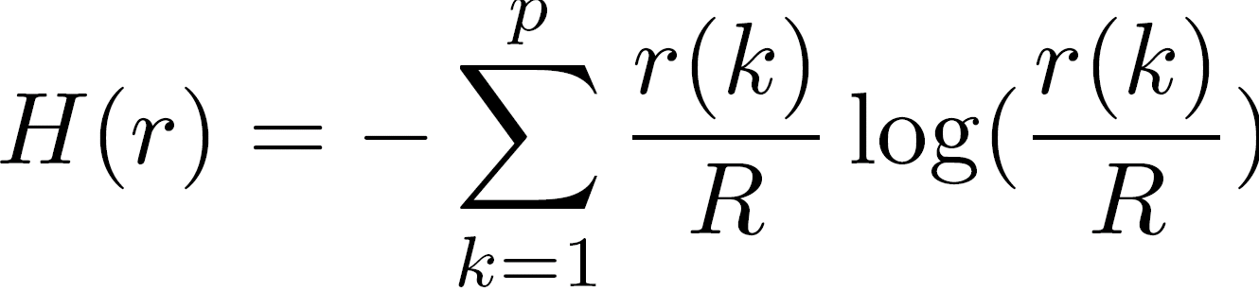
Notations
r(k): Number of parameters for node k
R: Total number of parameters
H: Entropy of the function r(.)/R

Slide 23
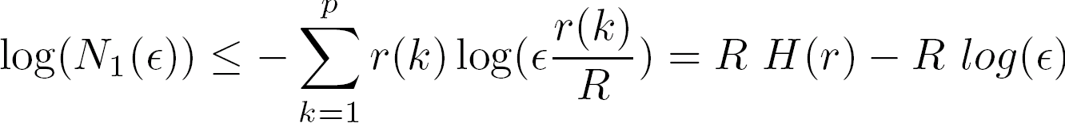
Theoretical Results
Covering Numbers bound
VC dim term
Entropy term
Bayesian Information Criterion (BIC) score (Schwartz 78)
Derive a new non-parametric learning criterion
(Consistent with Markov-equivalence)
Notes:
ERROR in the manuscript, in equation 2.4: S => R
Rajouter : derive score + Markov equivalent property

Slide 24
BN: Contributions
New criterion for parametric learning:
learning in BN
New criterion for structural learning:
Covering numbers bounds and structural entropy
New structural score
Consistency and optimality

Slide 25
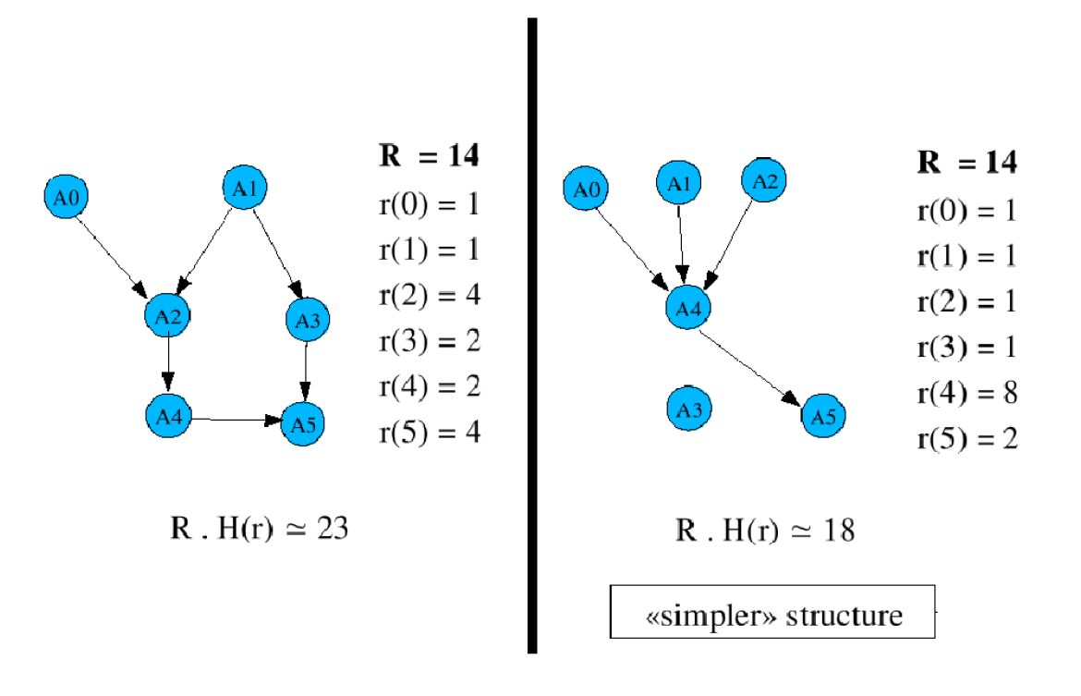
Structural Score

Slide 26
Contents
Theoretical and algorithmic contributions to Bayesian Network learning
Extensive assessment of learning, sampling, optimization algorithms in Dynamic Programming
Computer Go
Notes:
Dire contrib theorique sampling

Slide 27
Robust Dynamic Programming

Slide 28
Dynamic Programming
Sampling
Learning
Optimization
Notes:
Rajouter les 3 taches sur le transparent

Slide 29
Dynamic Programming
How to deal with that when too large or continuous?
Notes:
Rajouter les 3 taches sur le transparent

Slide 30
Why a principled assessment in ADP?
No comprehensive benchmark in ADP
ADP requires specific algorithmic strengths
Robustness wrt worst errors instead of average error
Each step is costly
Integration

Slide 31
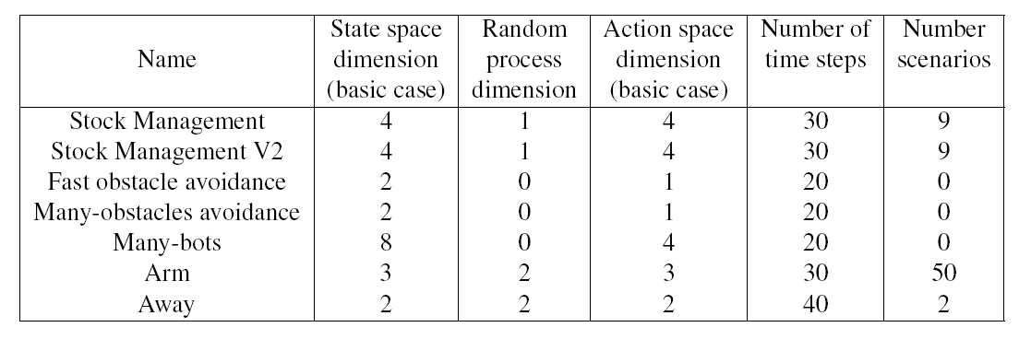
OpenDP benchmarks

Slide 32
DP: Contributions Outline
Experimental comparison in ADP:
Optimization
Learning
Sampling

Slide 33
Dynamic Programming
How to efficiently optimize over the actions?

Slide 34
Specific Requirements for optimization in DP
Robustness wrt local minima
Robustness wrt no smoothness
Robustness wrt initialization
Robustness wrt small nbs of iterates
Robustness wrt fitness noise
Avoid very narrow areas of good fitness

Slide 35
Non linear optimization algorithms
4 sampling-based algorithms (Random, Quasi-random, Low-Dispersion, Low-Dispersion “far from frontiers” (LD-fff) );
2 gradient-based algorithms (LBFGS and LBFGS with restart);
3 evolutionary algorithms (EO-CMA, EA, EANoMem);
2 pattern-search algorithms (Hooke&Jeeves, Hooke&Jeeves with restart).
Notes:
Dupliquer avec boite autour de QR

Slide 36
Non linear optimization algorithms
Further details in sampling section
4 sampling-based algorithms (Random, Quasi-random, Low-Dispersion, Low-Dispersion “far from frontiers” (LD-fff) );
2 gradient-based algorithms (LBFGS and LBFGS with restart);
3 evolutionary algorithms (EO-CMA, EA, EANoMem);
2 pattern-search algorithms (Hooke&Jeeves, Hooke&Jeeves with restart).
Notes:
Dupliquer avec boite autour de QR

Slide 37
Optimization experimental results
Notes:
Add a the same slide enlighting the 4th last columns
Dire qu’on parle de QR apres

Slide 38
Optimization experimental results
Better than random?
Notes:
Add a the same slide enlighting the 4th last columns
Dire qu’on parle de QR apres

Slide 39
Optimization experimental results
Evolutionary Algorithms and Low Dispersion discretisations are the most robust
Notes:
Add a the same slide enlighting the 4th last columns
Dire qu’on parle de QR apres

Slide 40
DP: Contributions Outline
Experimental comparison in ADP:
Optimization
Learning
Sampling

Slide 41
Dynamic Programming
How to efficiently approximate the state space?

Slide 42
Specific requirements of learning in ADP
Control worst errors (over several learning problems)
Appropriate loss function (L2 norm, Lp norm…)?
The existence of (false) local minima in the learned function values will mislead the optimization algorithms
The decay of contrasts through time is an important issue

Slide 43
Learning in ADP: Algorithms
K nearest neighbors
Simple Linear Regression (SLR) :
Least Median Squared linear regression
Linear Regression based on the Akaike criterion for model selection
Logit Boost
LRK Kernelized linear regression
RBF Network
Conjunctive Rule
Decision Table
Decision Stump
Additive Regression (AR)
REPTree (regression tree using variance reduction and pruning)
MLP MultilayerPerceptron (implementation of Torch library)
SVMGauss Support Vector Machine with Gaussian kernel (implementation of Torch library)
SVMLap (with Laplacian kernel)
SVMGaussHP (Gaussian kernel with hyperparameter learning)
Notes:
Parler des 4 derniers et faire un transparent de plus pour expliquer l’hp learning

Slide 44
Learning in ADP: Algorithms
K nearest neighbors
Simple Linear Regression (SLR) :
Least Median Squared linear regression
Linear Regression based on the Akaike criterion for model selection
Logit Boost
LRK Kernelized linear regression
RBF Network
Conjunctive Rule
Decision Table
Decision Stump
Additive Regression (AR)
REPTree (regression tree using variance reduction and pruning)
MLP MultilayerPerceptron (implementation of Torch library)
SVMGauss Support Vector Machine with Gaussian kernel (implementation of Torch library)
SVMLap (with Laplacian kernel)
SVMGaussHP (Gaussian kernel with hyperparameter learning)
Notes:
Parler des 4 derniers et faire un transparent de plus pour expliquer l’hp learning

Slide 45
Learning in ADP: Algorithms
For SVMGauss and SVMLap:
The hyper parameters of the SVM are chosen from heuristic rules
For SVMGaussHP:
An optimization is performed to find the best hyper parameters
50 iterations is allowed (using an EA)
Generalization error is estimated using cross validation
Notes:
Parler des 4 derniers et faire un transparent de plus pour expliquer l’hp learning

Slide 46
Learning experimental results
SVM with heuristic hyper-parameters are the most robust

Slide 47
DP: Contributions Outline
Experimental comparison in ADP:
Optimization
Learning
Sampling

Slide 48
Dynamic Programming
How to efficiently sample the state space?

Slide 49
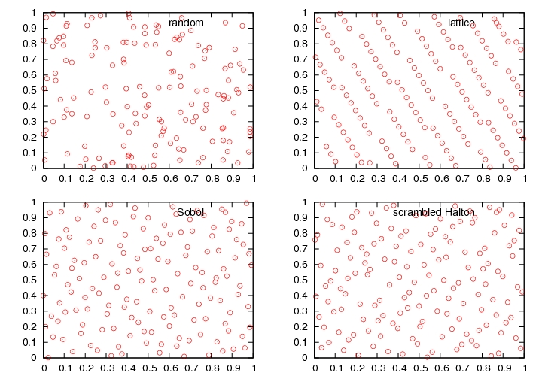
Quasi Random
Niederreiter (92)
Notes:
Rajouter ref QR

Slide 50
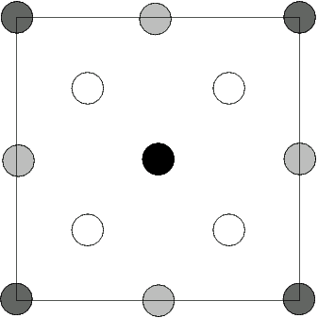
Sampling: algorithms
Pure random
QMC (standard sequences)
GLD: far from previous points
GLDfff: as far as possible from
- previous points
- the frontier
LD: numerically maximized distance between points (maxim. min dist)

Slide 51
Theoretical contributions
Pure deterministic samplings are not consistent
A limited amount of randomness is enough
Notes:
Ameliorer si possible

Slide 52
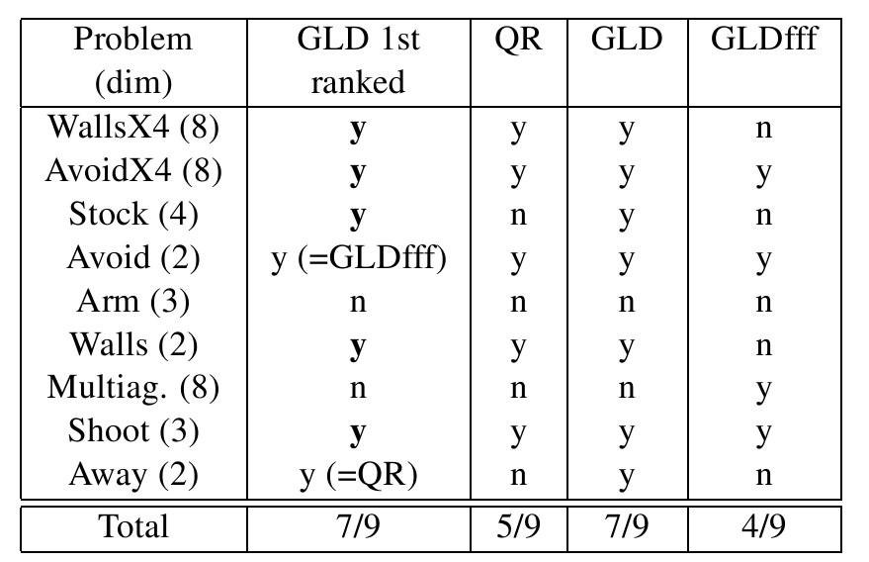
Sampling Results

Slide 53
Contents
Theoretical and algorithmic contributions to Bayesian Network learning
Extensive assessment of learning, sampling, optimization algorithms in Dynamic Programming
Computer Go
Notes:
Dire contrib theorique sampling

Slide 54
High Dimensional Discrete Case: Computer Go

Slide 55
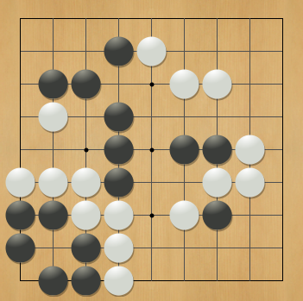
Computer Go
“Task Par Excellence for AI” (Hans Berliner)
“New Drosophila of AI” (John McCarthy)
“Grand Challenge Task” (David Mechner)

Slide 56
Can’t we solve it by DP?

Slide 57
Dynamic Programming
We perfectly know the model

Slide 58
Dynamic Programming
Everything is finite

Slide 59
Dynamic Programming
Easy

Slide 60
Dynamic Programming
Very hard!

Slide 61
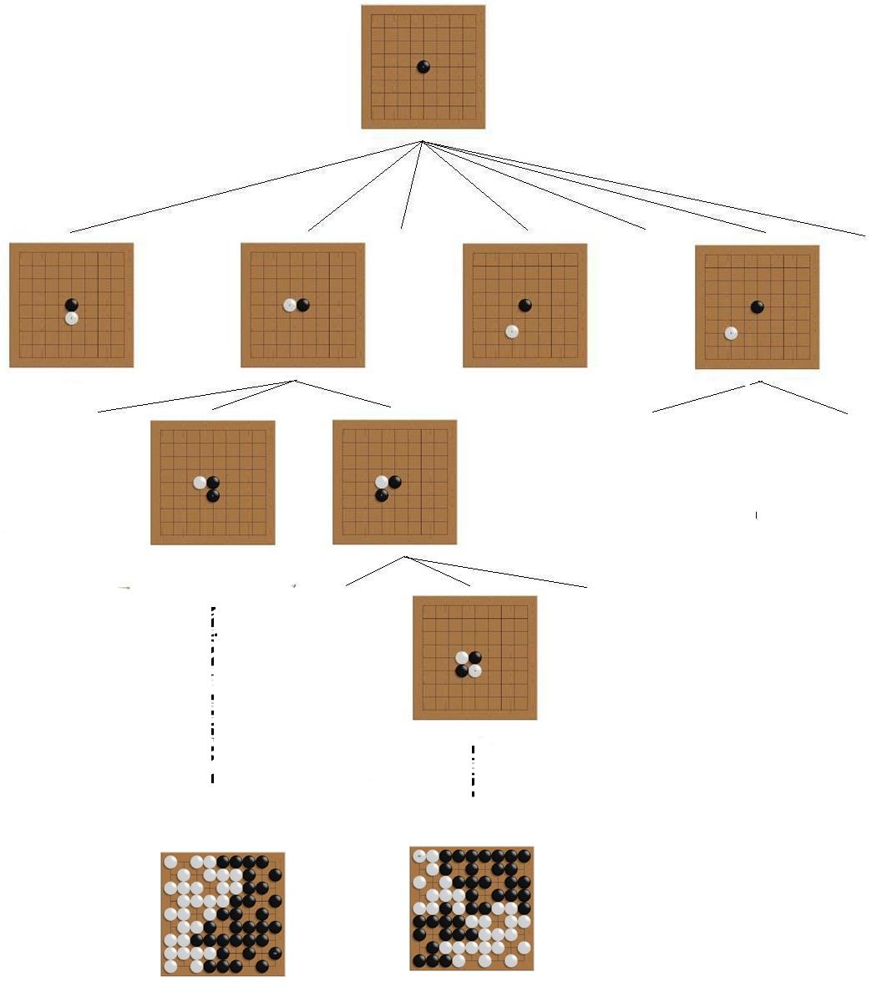
From DP to Monte-Carlo Tree Search
Why DP does not apply:
Size of the state space
New Approach
In the current state sample and learn to construct a locally specialized policy
Exploration/exploitation dilemma
Notes:
Ajouter des dessins

Slide 62
Computer Go: Outline
Online Learning: UCT
Combining Online and Offline Learning
Default Policy
RAVE
Prior Knowledge

Slide 63
Computer Go: Outline
Online Learning: UCT
Combining Online and Offline Learning
Default Policy
RAVE
Prior Knowledge

Slide 64
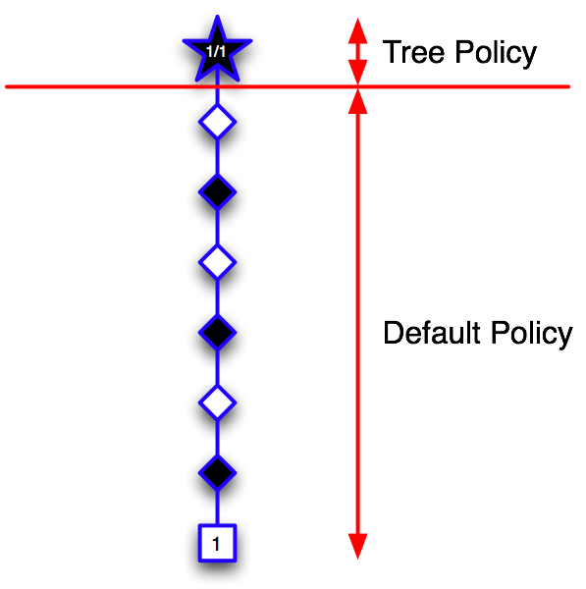

Monte-Carlo Tree Search
Coulom (06)
Chaslot, Saito & Bouzy (06)

Slide 65
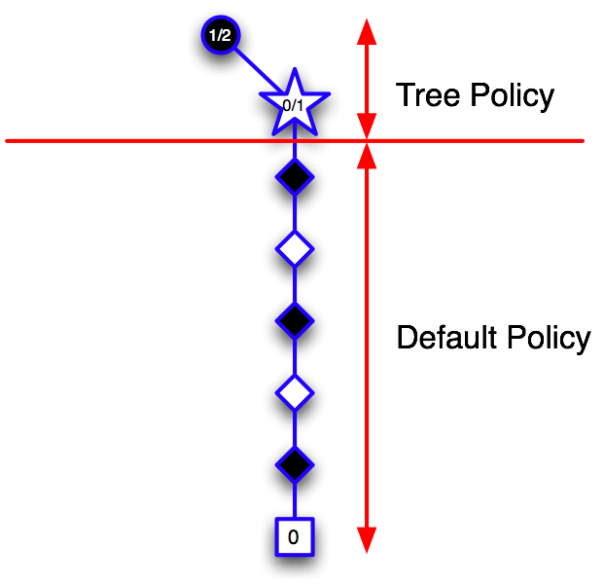
Monte-Carlo Tree Search

Slide 66
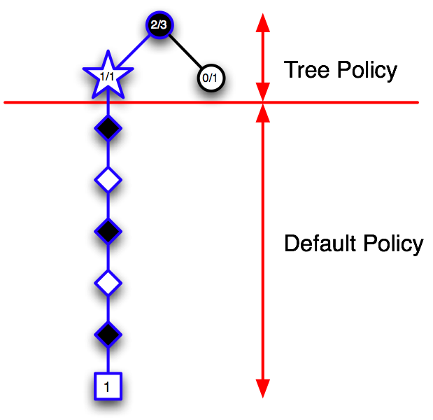
Monte-Carlo Tree Search

Slide 67
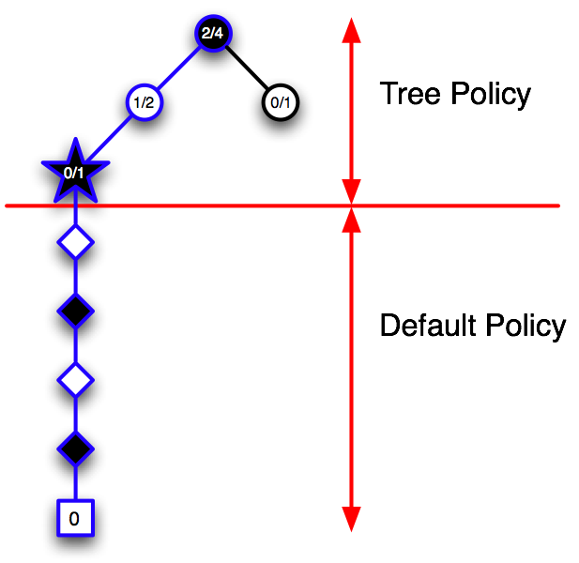
Monte-Carlo Tree Search

Slide 68
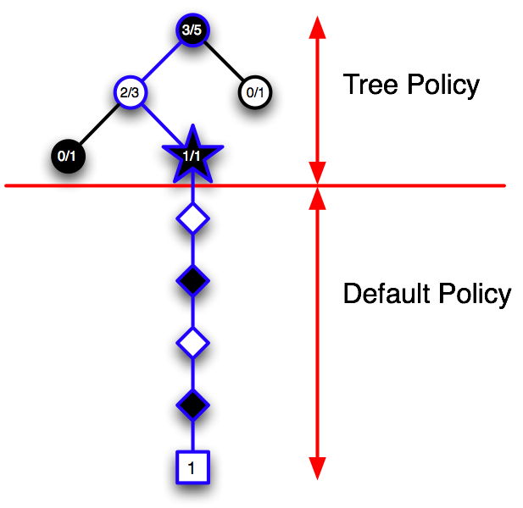
Monte-Carlo Tree Search

Slide 69
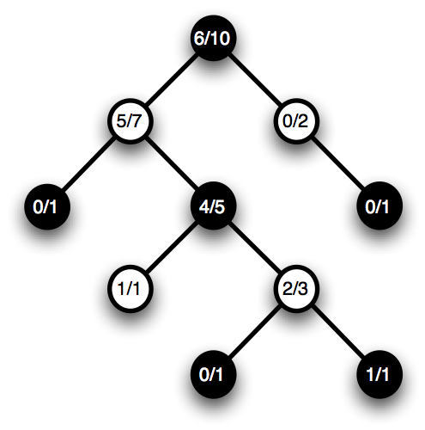
UCT
Kocsis & Szepesvari (06)

Slide 70
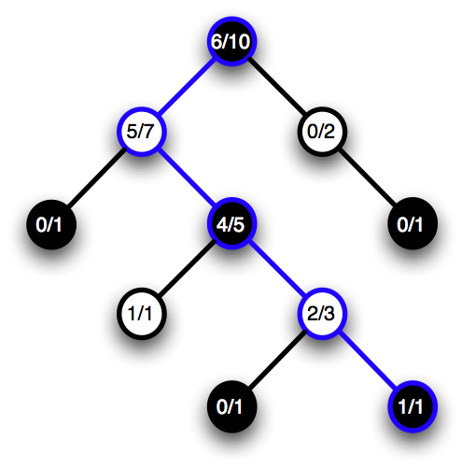
UCT

Slide 71
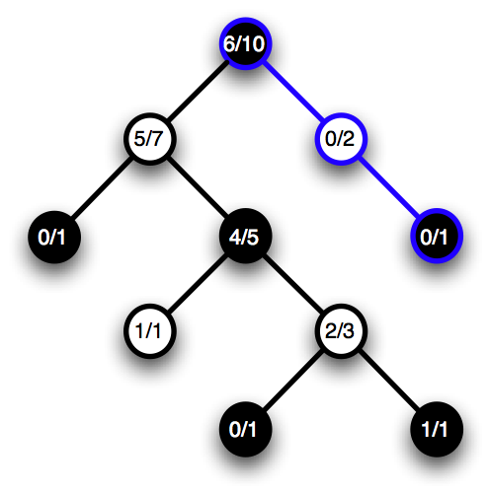
UCT

Slide 72

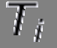

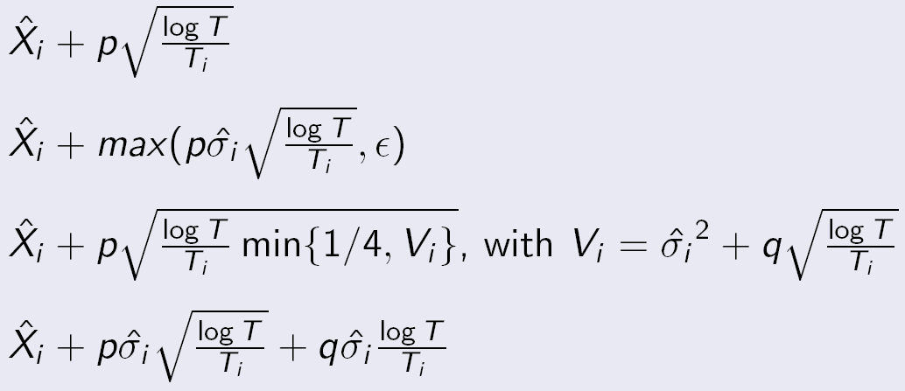
Exploration/Exploitation trade-off
Empirical average of rewards for move i
Number of trial for move i
Total number of trials
We choose the move i with the highest:
Notes:
Introduire notations a l’ecrit

Slide 73
Computer Go: Outline
Online Learning: UCT
Combining Online and Offline Learning
Default Policy
RAVE
Prior Knowledge

Slide 74
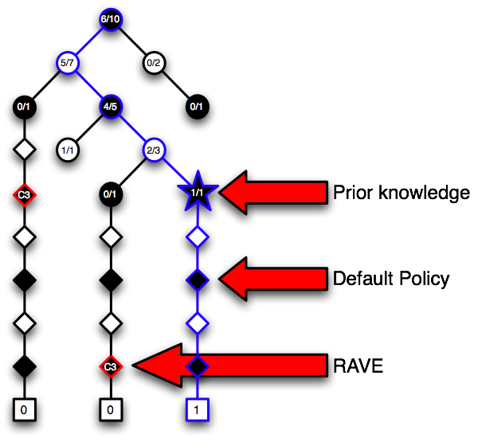
Overview
Online Learning:
QUCT(s,a)

Slide 75
Computer Go: Outline
Online Learning: UCT
Combining Online and Offline Learning
Default Policy
RAVE
Prior Knowledge

Slide 76

Default Policy
The default policy is crucial to UCT
Better default policy => better UCT (?)
As hard as the overall problem
Default policy must also be fast

Slide 77
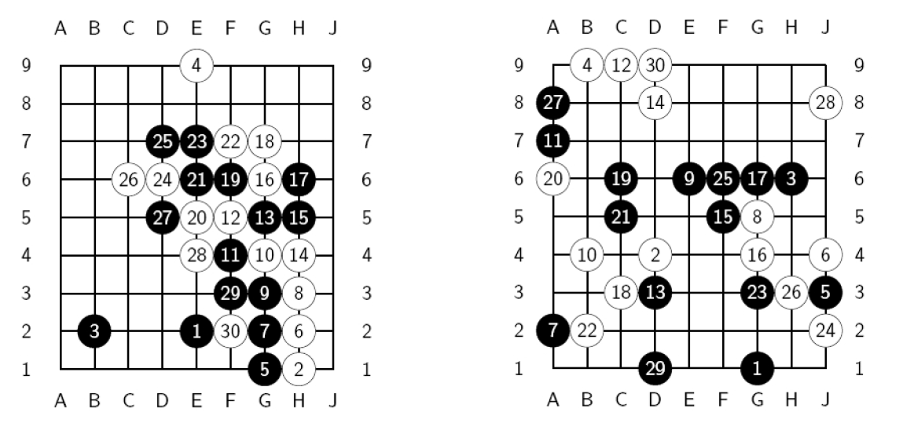
Educated simulations: Sequence-like simulations
Sequences matter!

Slide 78
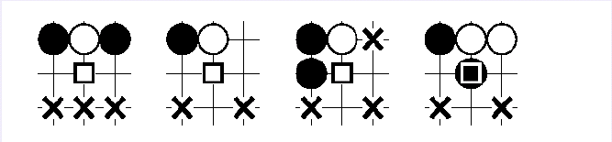
How it works in MoGo
Look at the 8 intersections around the previous move
For each such intersection, check the match of a pattern (including symetries)
If at least one pattern matches, play uniformly among matching intersections;
Else play uniformly among legal moves

Slide 79
Default Policy (continued)
The default policy is crucial to UCT
Better default policy => better UCT (?)
As hard as the overall problem
Default policy must also be fast

Slide 80
RLGO Default Policy
We use the RLGO value function to generate default policies
Randomised in three different ways
Epsilon greedy
Gaussian noise
Gibbs (softmax)

Slide 81
Surprise!
Default policy | Wins .v. GnuGo
Random | 8.9%
RLGO (best) | 9.4%
Handcrafted | 48.6%
RLGO wins ~90% against MoGo’s handcrafted default policy
But it performs worse as a default policy

Slide 82
Computer Go: Outline
Online Learning: UCT
Combining Online and Offline Learning
Default Policy
RAVE
Prior Knowledge

Slide 83
Rapid Action Value Estimate
UCT does not generalise between states
RAVE quickly identifies good and bad moves
It learns an action value function online

Slide 84
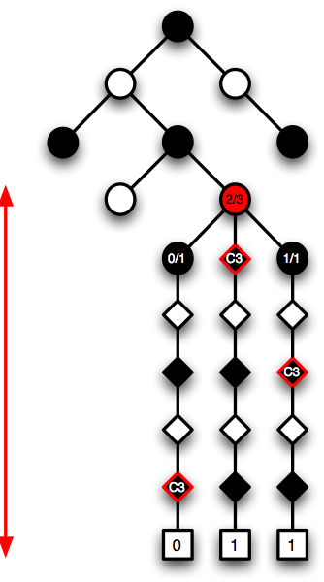
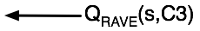
RAVE

Slide 85
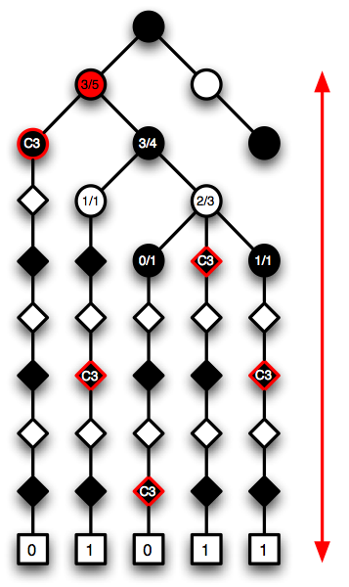
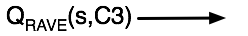
RAVE

Slide 86
UCT-RAVE
QUCT(s,a) value is unbiased but has high variance
QRAVE(s,a) value is biased but has low variance
UCT-RAVE is a linear blend of QUCT and QRAVE
Use RAVE value initially
Use UCT value eventually

Slide 87
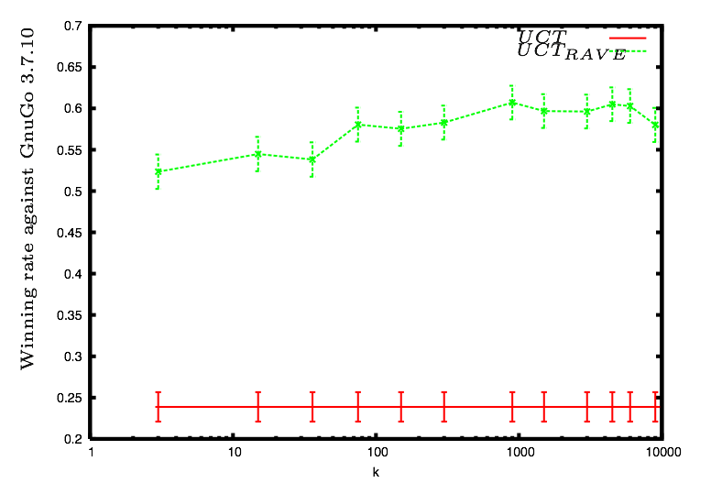
RAVE results

Slide 88
Cumulative Improvement
Algorithm | Wins vs. GnuGo | Standard error
UCT | 2% | 0.2%
+ Default Policy | 24% | 0.9%
+ RAVE | 60% | 0.8%
+ Prior Knowledge | 69% | 0.9%

Slide 89
Scalability
Simulations | Wins v. GnuGo | CGOS rating
3000 | 69% | 1960
10000 | 82% | 2110
70000 | 92% | 2320
50000 - 400000 | >98% | 2504

Slide 90

MoGo’s Record
9x9 Go
Highest rated Computer Go program
First dan-strength Computer Go program
Rated at 3-dan against humans on KGS
First victory against professional human player
19x19 Go
Gold medal in Computer Go Olympiad
Highest rated Computer Go program
Best Rated at 2-kyu against humans on KGS

Slide 91
Conclusions

Slide 92
Contributions 1) Model learning: Bayesian Networks
New parametric learning in BN (criterion ):
Directly linked to expectation approximation error
Consistent
Can directly deal with hidden variables
New structural score with entropy term:
More precise measure of complexity
Compatible with Markov equivalents
Guaranteed error bounds in generalization
Non parametric learning with convergence towards minimal structure and consistent

Slide 93
Contributions 2) Robust Dynamic Programming
Comprehensive experimental study in DP:
Non linear optimization
Regression Learning
Sampling
Randomness in sampling:
A minimum amount of randomness is required for consistency
Consistency can be achieved along with speed
Non blind sampler in ADP based on EA
Notes:
For each study, recall the best algorithms, but also emphasis that none are exempt of disadvantages

Slide 94
Contributions 3) MoGo
We combine online and offline learning in 3 ways
Default policy
Rapid Action Value Estimate
Prior knowledge in tree
Combined together, they achieve dan-level performance in 9x9 Go
Applicable to many other domains

Slide 95
Future work
Improve the scalability of our BN learning algorithm
Tackle large scale applications in ADP
Add approximation in UCT state representation
Massive Parallelization of UCT :
Specialized algorithm for exploiting massive parallel hardware
Notes:
First point (scalability in BN):
- Our algorithm is much more computationally intensive than the frequentist approach
- Our main computation is similar to inference in a BN: very efficient algorithms (taking advantage of the structure) exist for inference, it is likely that we can adapt them to our algorithm.
Second point (tackle real world application):
the scalability again is the main issue, but it is likely that a good integration of the state of the art tools of each domain can solve real world tasks.

